Slide 1
Travel Explorer Website
CAPSTONE PROJECT
PRESENTED BY:
DINESH KUMAR M BHARATH INSTITUTE OF HIGHER EDUCATION AND RESEARCH CSE(AIML)

Slide 2
OUTLINE
Problem Statement
System Development Approach (Technology Used)
Algorithm & Deployment (Step by Step Procedure)
Result
Conclusion
References

Slide 3
Problem Statement
Travelers often struggle to find essential information about destinations in one place.
Planning a trip requires switching between multiple apps for weather, images, and general details.
Lack of a unified, visually appealing interface for quick exploration of tourist spots.
Need for a simple web platform where users can preview destinations instantly.

Slide 4
System Approach
HTML5 for structure and layout of the website.
CSS3 for design, color gradients, and responsive layout.
JavaScript (optional extension planned) for future dynamic data fetching.
Unsplash API (static placeholders used) for destination photos.
OpenWeatherMap API (static demo version) for weather representation.
Responsive Design implemented using media queries for mobile adaptability

Slide 5
Algorithm & Deployment
Designed the project layout using HTML5 semantic elements – header, main, and sections.
Created a search bar interface to simulate destination input.
Integrated static demo data for “Paris” to represent weather and photo results.
Styled all components using CSS gradients, flexbox, and grid for a modern UI.
Embedded placeholder weather icons and Unsplash photos for visual appeal.
Tested responsiveness on multiple screen sizes to ensure mobile compatibility.
Deployed on a local host environment (can later be hosted via GitHub Pages).

Slide 6
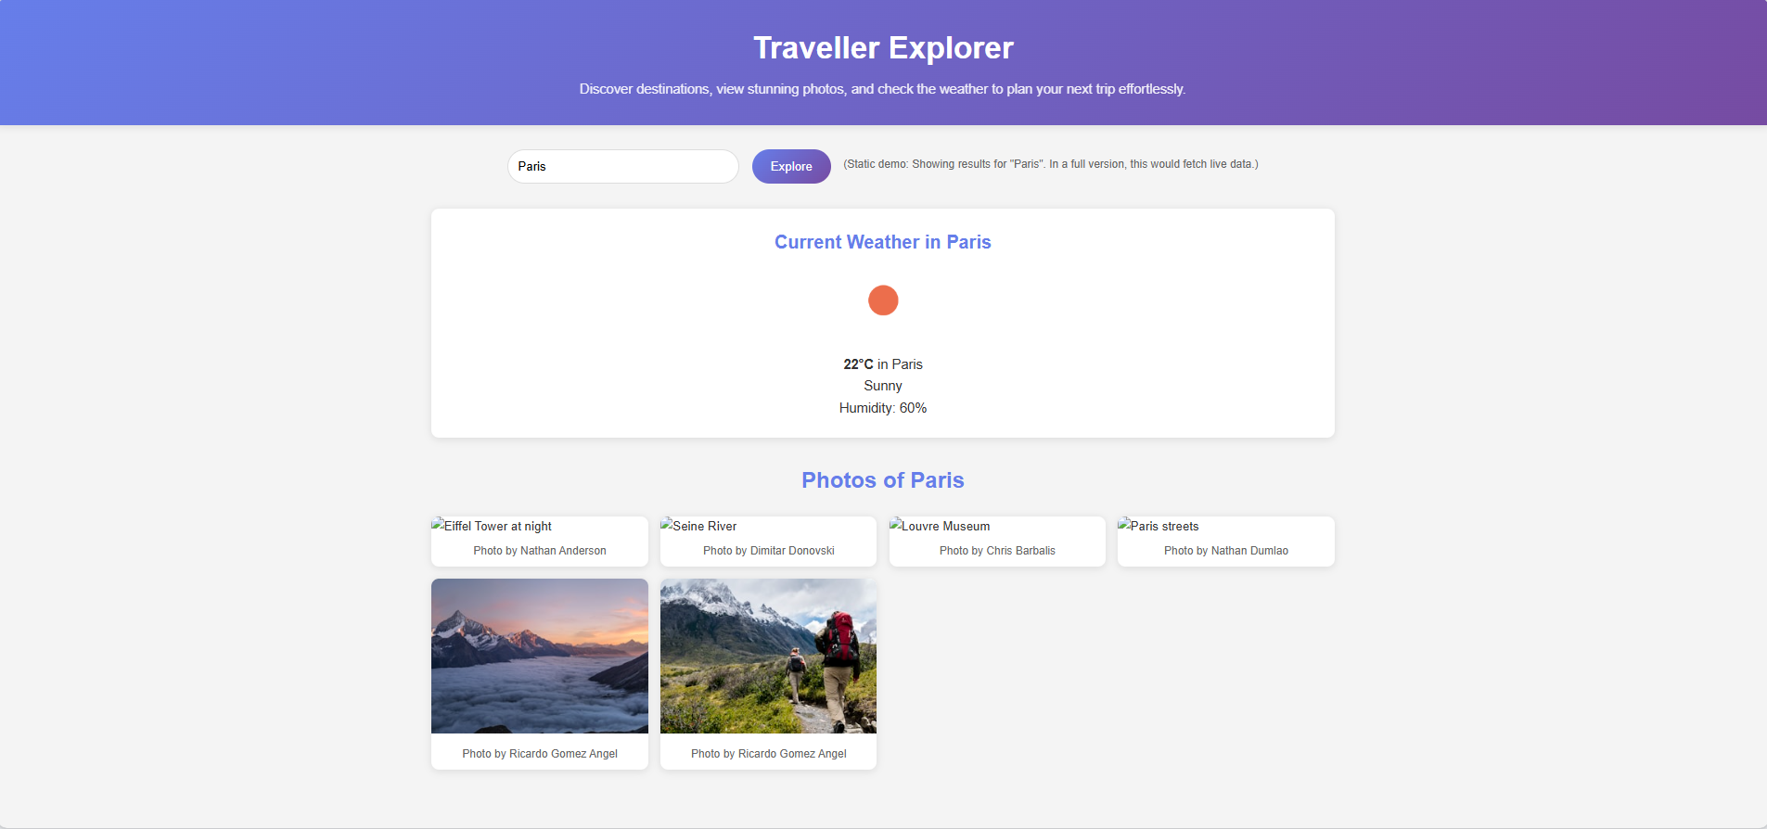
Result

Slide 7
GITHUB AND DEPLOYMNET LINK
Github Repo Link : https://github.com/Dinesh07-sys/Dinesh07-sys-AICTE-Traveller-Explorer-website--Front-End--
Deployment link: https://dinesh07-sys.github.io/Dinesh07-sys-AICTE-Traveller-Explorer-website--Front-End--/

Slide 8
Conclusion
The project successfully delivers an aesthetic and user-friendly front-end interface.
It lays the foundation for integrating real-time APIs to enhance interactivity.
Establishes proof of concept for a scalable travel information platform.

Slide 9
References
Unsplash – Royalty-free images used for destination visuals.
OpenWeatherMap – Source for weather API reference.
W3Schools – Front-end development documentation.
MDN Web Docs – HTML and CSS technical references.

Slide 10
“Travel makes one modest. You see what a tiny place you occupy in the world.” — Gustave Flaubert THANK YOU

